Slide 1

Crimson Bazaar
Spencer Kim and Helen Wu

Slide 2

Main Features
Useable app
Multiple trading markets (top trading cycle algorithm)
Trade décor, textbooks, etc.
Trading profile for each user
Preference elicitation
Trade confirmation (reputation system)

Slide 3



Technical details
Frontend
React Native / Redux framework
Backend
Firebase backend

Slide 4
Trading Markets
Use top trading cycles (TTC) algorithm for strategy proofness and Pareto optimality
Markets work in periods of 1 week
Every Sunday at midnight, the market closes and appropriate trades are computed
Notifications are sent out to those whose items will be traded

Slide 5


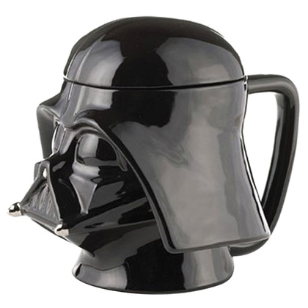

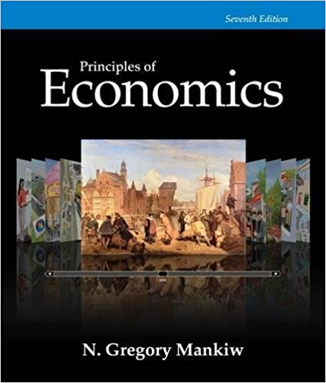
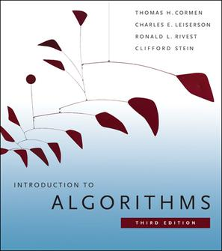
Trading profile
Displays reputation
Shows items currently submitted into trading markets
Limits 1 item per market per person to preserve strategy proofness
Lists outstanding trades
Profile
95% positive
Décor
Textbooks
Trades

Slide 6
Preference Elicitation Within Market
Order preferences using draggable tiles
Tiles show photo of item and seller reputation
Click tile to view details of item
Delete tile if user not willing to trade submitted item for it

Slide 7
Bootstrap the app (initializing the app)
Populate the market
Donated items from senior sales
Spencer, Helen, and friends’ old/unused books/décor
Generalized TTC
dummy agents used to trade these initially injected items

Slide 8
Reputation system
Encourage
following through with trades
timely trades
good quality items
Scan QR codes to confirm trades and rate experience (positive or negative)
only reveal after deadline for ratings to prevent retaliation

Slide 9
Evaluating the app
Not realistic to have large scale real user tests
Build test users with profiles that have
a threshold R for the reputation of users they will trade with
a probability p they will make a good trade
Use Selenium or pure code test to view results after multiple rounds
Analyze results with populations of different types of users
Number, quality, and value of transactions against R and p

